Slide 1
BBM 301 – Programming Languages Fall 2018, Lecture 2

Slide 2
Today
Implementation Methods
Describing Syntax and Semantics (Chapter 3)

Slide 3
Implementation Methods
Compilation
Programs are translated into machine language; includes JIT systems
Use: Large commercial applications
Pure Interpretation
Programs are interpreted by another program known as an interpreter
Use: Small programs or when efficiency is not an issue
Hybrid Implementation Systems
A compromise between compilers and pure interpreters
Use: Small and medium systems when efficiency is not the first concern

Slide 4


Compilation and Interpretation
Compiler translates into target language (machine language), then goes away
The target program is the locus of control at execution time
Interpreter stays around at execution time
Implements a virtual machine whose machine language is the high-level language

Slide 5
Compilation
Translate high-level program (source language) into machine code (machine language)
Slow translation, fast execution
Compilation process has several phases:
lexical analysis: converts characters in the source program into lexical units
syntax analysis: transforms lexical units into parse trees which represent the syntactic structure of program
Semantics analysis: generate intermediate code
code generation: machine code is generated
Example: C, C++, COBOL, Ada

Slide 6
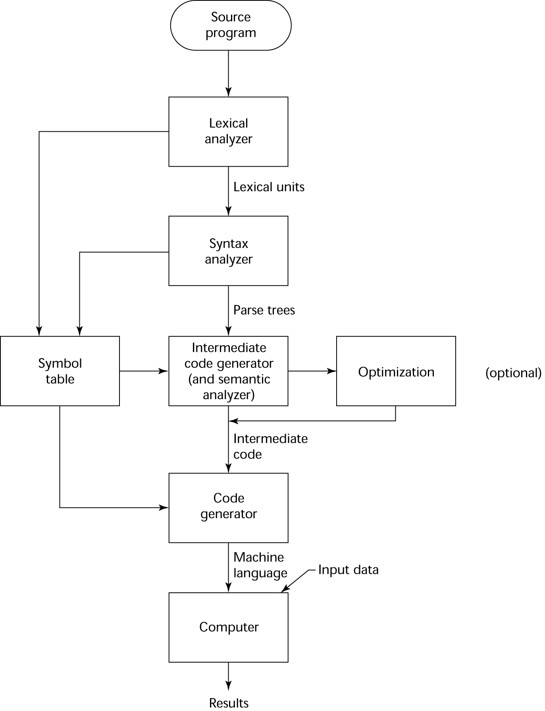
Compilation
Source language: The language that the compiler translates
Lexical analyzer: gathers the characters of the source program into lexical units (e.g. identifiers, special words, operators, punctuation symbols) Ignores the comments
Syntax analyzer: takes the lexical units, and use them to construct parse trees, which represent the syntactic structure of the program
Intermediate code generator: Produces a program at an intermediate level. Similar to assembly languages

Slide 7
Compilation
Semantic analyzer: checks for errors that are difficult to check during syntax analysis, such as type errors.
Optimization (optional): Used if execution speed is more important than compilation speed.
Code generator: Translates the intermediate code to machine language program.
Symbol table: serves as a database of type and attribute information of each user defined name in a program. Placed by lexical and syntax analyzers, and used by semantic analyzer and code generator.

Slide 8
Pure Interpretation
No translation.
Each statement is decoded and executed individually.
The interpreter program acts as a software simulation of a machine
Advantages:
Easier implementation of programs
Debugging is easy (run-time errors can easily and immediately be displayed)
Disadvantages:
Slower execution (10 to 100 times slower than compiled programs, and statement decoding is the major bottleneck)
Often requires more space
Now rare for traditional high-level languages but available in some Web scripting languages (e.g., JavaScript, PHP)
Notes:
8

Slide 9
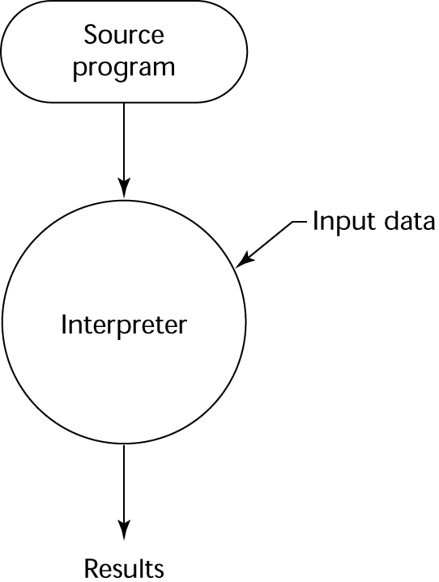
Pure Interpretation Process
Notes:
9

Slide 10
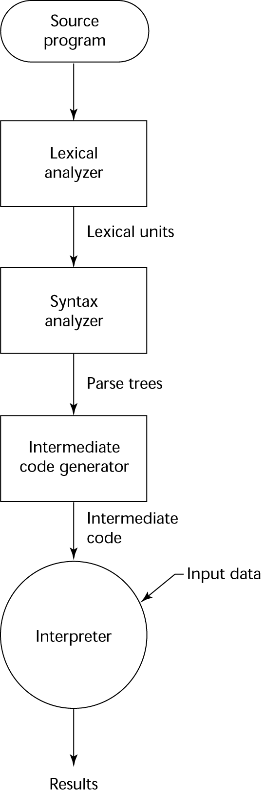
Hybrid Implementation Systems
A compromise between compilers and pure interpreters
A high-level language program is translated to an intermediate language that allows easy interpretation
Faster than pure interpretation
Example: Perl programs are partially compiled to detect errors before interpretation
Notes:
10

Slide 11
Today
Implementation Methods
Describing Syntax and Semantics (Chapter 3)

Slide 12
Creating computer programs
Each programming language provides a set of primitive operations
Each programming language provides mechanisms for combining primitives to form more complex, but legal, expressions
Each programming language provides mechanisms for deducing meanings or values associated with computations or expressions
E. Grimson, J. Guttag and C. Terman

Slide 13
Aspects of languages
Primitive constructs
Programming language: numbers, strings, simple operators
English : words
Syntax– which strings of characters and symbols are well‐formed
Programming language: 3.2 + 3.2 is a valid C expression
English: “cat dog boy” is not syntactically valid, as not in form of acceptable sentence
E. Grimson, J. Guttag and C. Terman

Slide 14
Aspects of languages
Static semantics – which syntactically valid strings have a meaning
English – “I are big” has form <noun> <intransitive verb> <noun>, so syntactically valid, but is not valid English because “I” is singular, “are” is plural
Programming language – for example, <literal> <operator> <literal> is a valid syntactic form, but 2.3/”abc” is a static semantic error!
E. Grimson, J. Guttag and C. Terman

Slide 15
Aspects of languages
Semantics – what is the meaning associated with a syntactically correct string of symbols with no static semantic errors
English – can be ambiguous
“I cannot praise this student too highly”
“Yaşlı adamın yüzüne dalgın dalgın baktı.”
Programming languages – always has exactly one meaning
But meaning (or value) may not be what programmer intended
E. Grimson, J. Guttag and C. Terman

Slide 16
Where can things go wrong?
Syntactic errors
Common but easily caught by computer
Static semantic errors
Some languages check carefully before running, others check while interpreting the program
If not caught, behavior of program unpredictable
Programs don’t have semantic errors, but meaning may not be what was intended
Crashes (stops running)
Runs forever
Produces an answer, but not programmer’s intent

Slide 17
Today
Syntax: the form or structure of the expressions, statements, and program units
Semantics: the meaning of the expressions, statements, and program units
Syntax and semantics provide a language’s definition
Users of a language definition
Other language designers
Implementers
Programmers (the users of the language)
Notes:
17

Slide 18
Example: Syntax and Semantics
while statement in Java
syntax: while (<boolean_expr>) <statement>
semantics: when boolean_expr is true, statement will be executed
The meaning of a statement should be clear from its syntax (Why?)
Notes:
(Consider the word static in C)

Slide 19
Describing Syntax: Terminology
Alphabet: Σ, All strings: Σ*
A sentence is a string of characters over some alphabet
A language is a set of sentences, L ⊆ Σ*
Notes:
19

Slide 20
Describing Syntax: Terminology
A language is a set of sentences
Natural languages: English, Turkish, …
Programming languages: C, Fortran, Java,…
Formal languages: a*b*, 0^{n}1^{n}
String of the language:
Sentences
Program statements
Words (aaaaabb, 000111)

Slide 21
Lexemes
A lexeme is the lowest level syntactic unit of a language (e.g., *, sum, begin)
Lower level constructs are given not by the syntax but by lexical specifications.
Examples: identifiers, constants, operators, special words.
total, sum_of_products, 1254, ++, ( :
So, a language is considered as a set of strings of lexemes rather than strings of chars.

Slide 22
Token
A token of a language is a category of lexemes
For example, identifier is a token which may have lexemes, or instances, sum and total

Slide 23
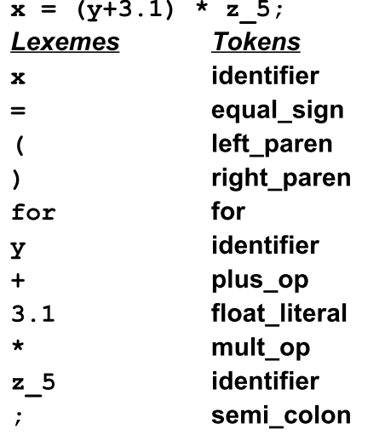
Example in Java Language
x = (y+3.1) * z_5 ;

Slide 24
Describing Syntax
Higher level constructs are given by syntax rules.
Syntax rules specify which strings from Σ* are in the language
Examples: organization of the program, loop structures, assignment, expressions, subprogram definitions, and calls.

Slide 25
Elements of Syntax
An alphabet of symbols
Symbols are terminal and non-terminal
Terminals cannot be broken down
Non-terminals can be broken down further
Grammar rules that express how symbols are combined to make legal sentences
Rules are of the general form
non-terminal symbol ::= list of zero or more terminals or non-terminals
One uses rules to recognize (parse) or generate legal sentences

Slide 26
Formal Definition of Languages
Recognizers
A recognition device reads input strings over the alphabet of the language and decides whether the input strings belong to the language
Example: syntax analysis part of a compiler
Generators
A device that generates sentences of a language
One can determine if the syntax of a particular sentence is syntactically correct by comparing it to the structure of the generator
Notes:
26

Slide 27
Formal Methods of Describing Syntax
Grammars: formal language-generation mechanisms.
In the mid-1950s, Chomsky, described four classes of generative devices (or grammars) that define four classes of languages.
Two of these grammar classes, named context-free and regular, turned out to be useful for describing the syntax of programming languages.
Regular grammars: The forms of the tokens of programming languages
Context-free grammars: The syntax of whole programming
Notes:
27

Slide 28
Regular Language vs CFL
Tokens can be generated using three formal rules
Concatenation
Alternation (|)
Kleene closure (repetition an arbitrary number of times)(*)
Any sets of strings that can be defined by these three rules is called a regular set or a regular language
Any set of strings that can be defined if we add recursion is called context-free language (CFL).

Slide 29
Context-Free Grammars
Context-Free Grammars
Developed by Noam Chomsky in the mid-1950s
Language generators, meant to describe the syntax of natural languages
Define the class of context-free languages
Programming languages are contained in the class of CFL’s.
Notes:
29

Slide 30
Backus-Naur Form (BNF)
A notation to describe the syntax of programming languages.
Named after
John Backus – Algol 58
Peter Naur – Algol 60
A metalanguage is a language used to describe another language.
BNF is a metalanguage used to describe PLs.

Slide 31
BNF Fundamentals
BNF uses abstractions for syntactic structures.
<LHS> → <RHS>
LHS: abstraction being defined
RHS: definition
“→” means “can have the form”
Sometimes ::= is used for →

Slide 32
BNF Fundamentals
Example, Java assignment statement can be represented by the abstraction <assign>
<assign> → <var> = <expression>
This is a rule or production
Here, <var> and <expression> must also be defined.
example instances of this abstraction can be
total = sub1 + sub2
myVar = 4

Slide 33
BNF Fundamentals
These abstractions are called Variables or Nonterminals of a Grammar.
Lexemes and tokens are the Terminals of a grammar.
Nonterminals are often enclosed in angle brackets
Examples of BNF rules:
<ident_list> → identifier | identifier, <ident_list>
<if_stmt> → if <logic_expr> then <stmt>

Slide 34
BNF Fundamentals
A formal definition of rule:
A rule has a left-hand side (LHS), which is a nonterminal, and a right-hand side (RHS), which is a string of terminals and/or nonterminals
<LHS> → <RHS>
Grammar: a finite non-empty set of rules

Slide 35
Examples

Slide 36
An initial example
Consider the sentence “Mary greets John”
A simple grammar
<sentence> ::= <subject><predicate>
<subject> ::= Mary
<predicate> ::= <verb><object>
<verb> ::= greets
<object> ::= John

Slide 37
Alternations
Multiple definitions can be separated by | (OR).
<object> ::= John | Alfred
This adds “Mary greets Alfred” to legal sentences
<subject> ::= Mary | John | Alfred
<object> ::= Mary | John | Alfred
Alternation to the previous grammar
<sentence> ::= <subject><predicate>
<subject> ::= <noun>
<predicate> ::= <verb><object>
<verb> ::= greets
<object> ::= <noun>
<noun> ::= Mary | John | Alfred

Slide 38
Infinite Number of Sentences
<object> ::= John |
John again |
John again and again |
….
Instead use recursive definition
<object> ::= John |
John <repeat factor>
<repeat factor> ::= again |
again and <repeat factor>
A rule is recursive if its LHS appears in its RHS

Slide 39
Simple example for PLs
How you can describe simple arithmetic?
<expr> ::= <expr> <operator> <expr> |<var>
< operator > ::= + | - | * | /
<var> ::= a | b | c | …
<var> ::= <signed number>
<signed number> ::= + <number> | - <number>
<number> ::= <number> <digit> | <digit>
….
….

Slide 40
Identifiers
<identifier> → <letter> |
<identifier><letter> |
<identifier><digit>

Slide 41
PASCAL/Ada If Statement
<if_stmt> → if <logic_expr> then <stmt>
<if_stmt> → if <logic_expr> then <stmt>
else <stmt>
Or
<if_stmt> → if <logic_expr> then <stmt>
| if <logic_expr> then <stmt> else
<stmt>

Slide 42
Grammars and Derivations
A grammar is a generative device for defining languages
The sentences of the language are generated through a sequence of applications of the rules, starting from the special nonterminal called start symbol.
Such a generation is called a derivation.
Start symbol represents a complete program. So it is usually named as <program>.

Slide 43
An Example Grammar
<program> → begin <stmt_list> end
<stmt_list> → <stmt> |
<stmt> ; <stmt_list>
<stmt> → <var> := <expression>
<var> → A | B | C
<expression>→ <var> |
<var> <arith_op> <var>
<arith_op> → + | - | * | /
Notes:
43

Slide 44
Derivation
In order to check if a given string represents a valid program in the language, we try to derive it in the grammar.
Derivation starts from the start symbol <program>.
At each step we replace a nonterminal with its definition (RHS of the rule).

Slide 45
Derivations
Every string of symbols in a derivation is a sentential form
A sentence is a sentential form that has only terminal symbols
A leftmost derivation is one in which the leftmost nonterminal in each sentential form is the one that is expanded
A derivation may be neither leftmost nor rightmost

Slide 46
An Example Derivation

Slide 47
An Example Derivation
Derive string: begin A := B; C := A * B end
<program> ⇒ begin <stmt_list> end
⇒ begin <stmt> ; <stmt_list> end
⇒ begin <var> := <expression>; <stmt_list> end
⇒ begin A := <expression>; <stmt_list> end
⇒ begin A := B; <stmt_list> end
⇒ begin A := B; <stmt> end
⇒ begin A := B; <var> := <expression> end
⇒ begin A := B; C := <expression> end
⇒ begin A := B; C := <var><arith_op><var> end
⇒ begin A := B; C := A <arith_op> <var> end
⇒ begin A := B; C := A * <var> end
⇒ begin A := B; C := A * B end
sentential
form
If always the leftmost nonterminal is replaced, then it is called leftmost derivation.

Slide 48
Parse Tree
A hierarchical representation of a derivation
<program> → <stmt_list>
<stmt_list> → <stmt>
| <stmt> ; <stmt_list>
<stmt> → <var> = <expr>
<var> → a | b | c | d
<expr> → <term> + <term>
| <term> - <term>
<term> → <var> | const
<program>
<stmt_list>
<stmt>
=
<expr>
<var>
a
<term>
+
<term>
<var>
const
a
b
Copyright © 2009 Addison-Wesley. All rights reserved.
1-48
Notes:
48

Slide 49
Parse Tree of the Example

Slide 50
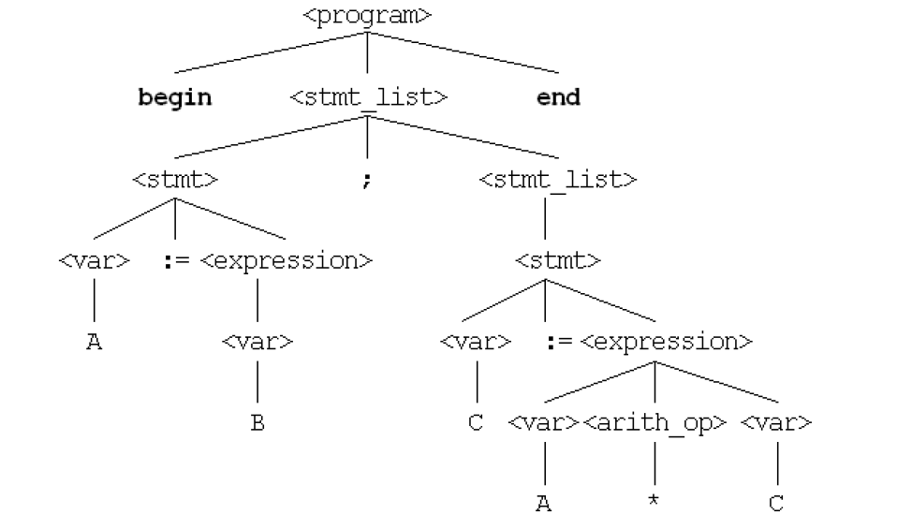
Parse Tree of the Example
B

Slide 51
Ambiguity (Belirsizlik) in Grammars
A grammar is ambiguous if and only if it generates a sentential form that has two or more distinct parse trees
Copyright © 2009 Addison-Wesley. All rights reserved.
1-51
Notes:
51

Slide 52
Example
Given the following grammar
<assign> ::= <id> = <expr>
<id> ::= A | B | C
<expr> ::= <expr> + <expr>
| <expr> * <expr>
| (<expr>)
| <id>
Parse Tree(s) for A = B + C * A

Slide 53
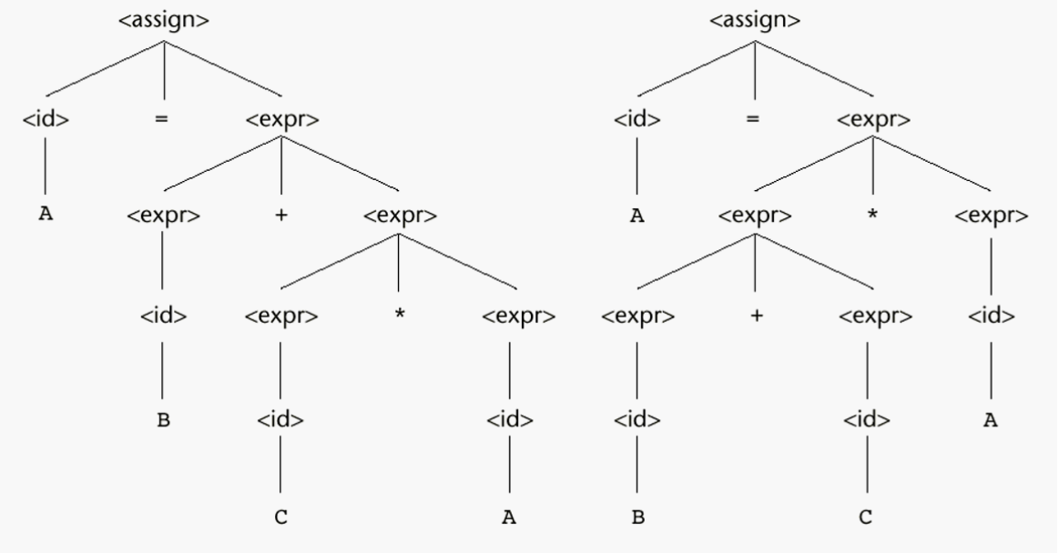
Parse Trees for A = B + C * A

Slide 54
Ambiguity
The grammar of a PL must not be ambiguous
There are solutions for correcting the ambiguity
Operator precedence
Associativity rules

Slide 55
Operator Precedence
In mathematics * operation has a higher precedence than +
This can be implemented with extra nonterminals
<assign> ::= <id> = <expr>
<id> ::= A | B | C
<expr> ::= <expr> + <expr>
| <expr> * <expr>
| (<expr>)
| <id>
<assign> ::= <id> = <expr>
<id> ::= A | B | C
<expr> ::= <expr> + <term>
| <term>
<term> ::= <term> * <factor>
| <factor>
<factor> ::= (<expr>)
| <id>

Slide 56
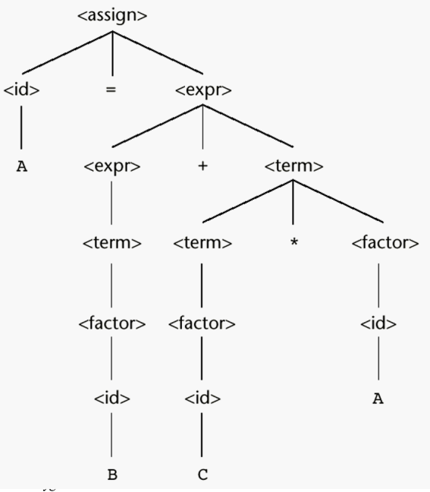
Unique Parse Tree for A = B + C * A

Slide 57
Associativity of Operators
What about equal precedence operators?
In math addition and multiplication are associative
A+B+C = (A+B)+C = A+(B+C)
However computer arithmetic may not be associative
Ex: for floating point addition where floating points values store 7 digits of accuracy, adding eleven numbers together where one of the numbers is 10⁷ and the others are 1 result would be 1.000001 * 10⁷ only if the ten 1s are added first
Subtraction and division are not associative
A/B/C/D = ? ((A/B)/C)/D ≠A/(B/(C/D))

Slide 58
Associativity of Operators
Operator associativity can also be indicated by a grammar
<expr> -> <expr> + <expr> | const (ambiguous)
<expr> -> <expr> + const | const (unambiguous)
<expr>
<expr>
<expr>
+
const
<expr>
+
const
const
Copyright © 2009 Addison-Wesley. All rights reserved.
1-58
Notes:
58

Slide 59
Associativity (birleşirlik)
In a BNF rule, if the LHS appears at the beginning of the RHS, the rule is said to be left recursive
Left recursion specifies left associativity
<expr> ::= <expr> + <term>
| <term>
Similar for the right recursion
In most of the languages exponential is defined as a right associative operation
<factor> ::= <expr> ** <factor>
| <expr>
<expr> ::= (<expr>)
| <id>

Slide 60
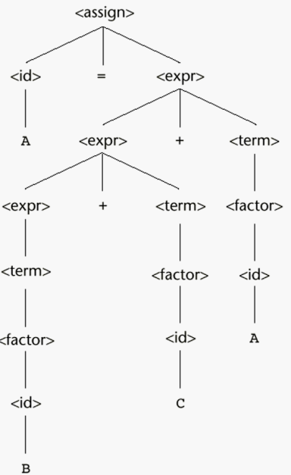
A parse tree for A = B + C + A illustrating the associativity of addition
Left associativity
Left addition is lower than the right addition

Slide 61
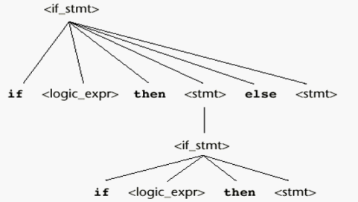
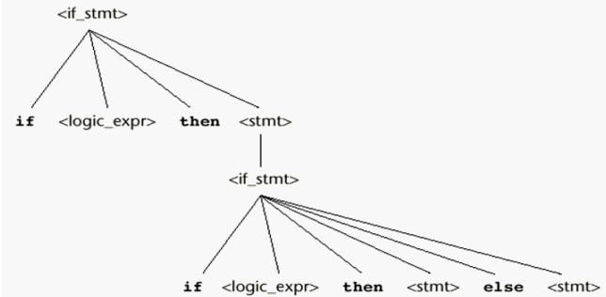
Is this ambiguous?
<stmt> ::= <if_stmt>
<if_stmt> ::= if <logic_expr> then <stmt>
| if <logic_expr> then <stmt> else <stmt>
Derive for : If C1 then if C2 then A else B

Slide 62
An Unambiguous grammar for “if then else”
Dangling else problem: there are more if then else
To design an unambiguous if-then-else statement we have to decide which if a dangling else belongs to
Most PL adopt the following rule:
“an else is matched with the closest previous unmatched if statement”
(unmatched if = else-less if)
Has a unique parse tree
<stmt> ::= <matched> | <unmatched>
<matched> ::= if <logic_expr> then <matched> else <matched>
| any non-if-statement
<unmatched> ::= if <logic_expr> then <stmt>
| if <logic_expr> then <matched> else <unmatched>

Slide 63
Draw the parse tree
<stmt> ::= <matched> | <unmatched>
<matched> ::= if <logic_expr> then <matched> else <matched>
| any non-if-statement
<unmatched> ::= if <logic_expr> then <stmt>
| if <logic_expr> then <matched> else <unmatched>
If C1 then if C2 then A else B

Slide 64
Extended BNF
EBNF: Same power but more convenient
Optional parts are placed in brackets [ ]
[X] : X is optional (0 or 1 occurrence)
<writeln> ::= WRITELN [(<item_list>)]
<selection>::= if (<expr>) <stmt> [else<stmt>]
Repetitions (0 or more) are placed inside braces { }
{X}: 0 or more occurrences
<identlist> = <identifier> {,<identifier>}
Alternative parts of RHSs are placed inside parentheses and separated via vertical bars
(X1|X2|X3) : choose X1 or X2 or X3
<term> → <term> (+|-) const

Slide 65
BNF vs Extended BNF
BNF
< expr> ::= <expr> + <term>
| <expr> - <term>
| <term>
<term> ::= <term> * <factor>
| <term> / <factor>
| <factor>
<factor> ::= <expr> ** <factor>
| <expr>
<expr> ::= (<expr>)
| <id>

Slide 66
BNF vs Extended BNF
EBNF
<expr> ::= <term> {(+ | -) <term>}
<term> ::= <factor> {(*|/) <factor>}
<factor> ::= <expr> {**<expr>}
<expr> ::= (<expr>)
| id

Slide 67
Recent Variations in EBNF
Alternative RHSs are put on separate lines
Use of a colon instead of =>
Use of _{opt} for optional parts
Use of oneof for choices

Slide 68
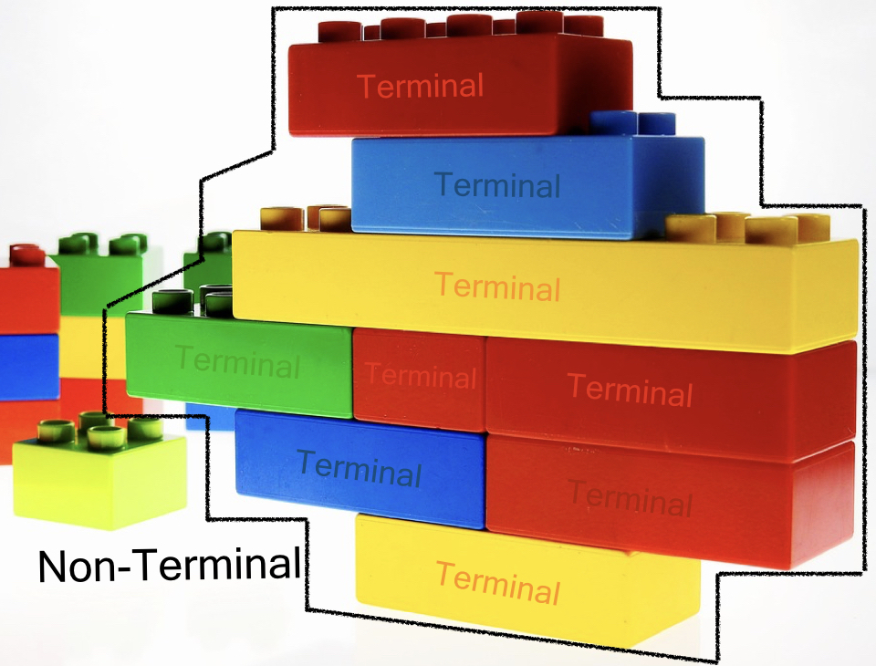
Additional Notes on Terminals and NonTerminals
Source: https://tomassetti.me/ebnf/

Slide 69
Additional Notes on Terminals and NonTerminals
Terminals are the smallest block we consider in our grammars.
A terminal could be either:
a quoted literal
a regular expression
a name referring to a terminal definition.

Slide 70
Terminals
Let’s see some typical terminals:
identifiers: these are the names used for variables, classes, functions, methods and so on.
keywords: almost every language uses keywords. They are exact strings that are used to indicate the start of a definition (think about class in Java or def in Python), a modifier (public, private, static, final, etc.) or control flow structures (while, for, until, etc.)

Slide 71
Terminals
literals: these permit to define values in our languages. We can have string literals, numeric literal, char literals, boolean literals (but we could consider them keywords as well), array literals, map literals, and more, depending on the language
separators and delimiters: like colons, semicolons, commas, parenthesis, brackets, braces
whitespaces: spaces, tabs, newlines.
comments

Slide 72
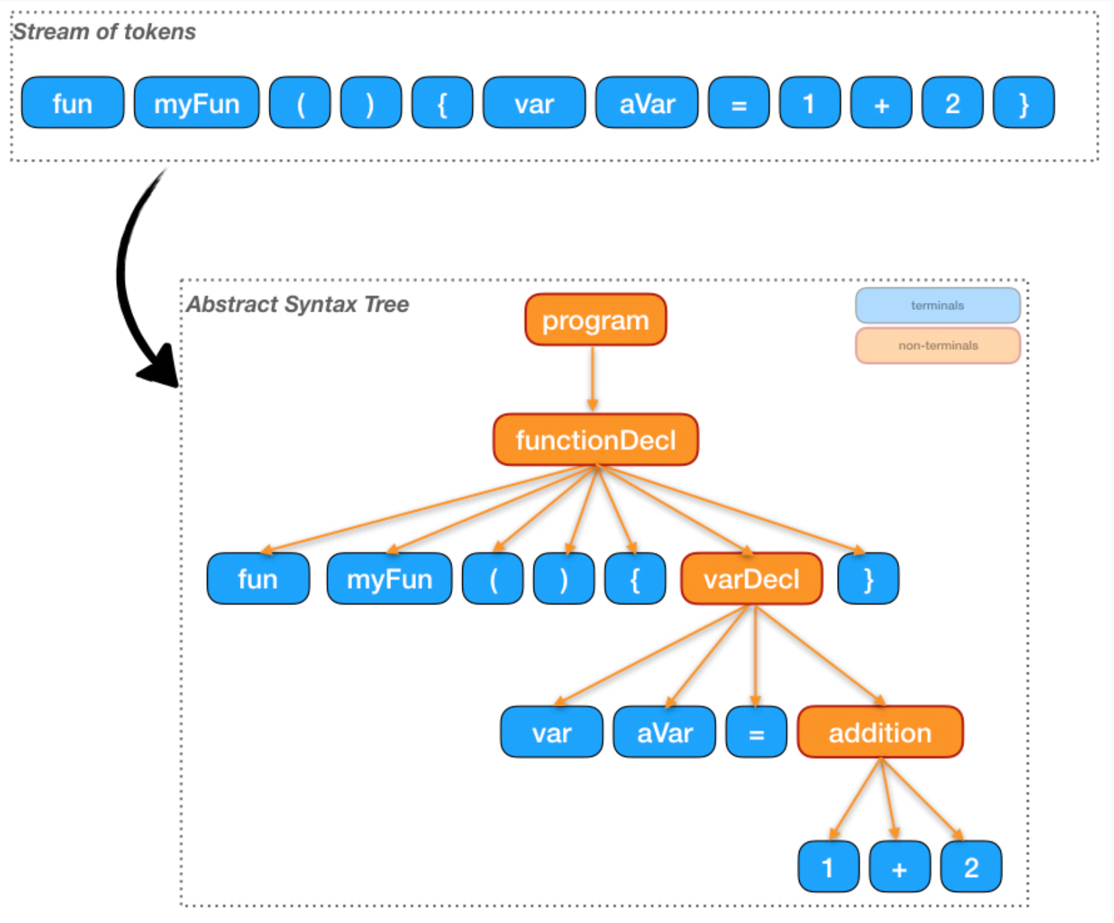
Terminals and Non-terminals
Source: https://tomassetti.me/ebnf/

Slide 73
Non-terminals
Examples of non-terminals are:
program/document: represent the entire file
module/classes: group several declarations togethers
functions/methods: group statements together
statements: these are the single instructions. Some of them can contain other statements. Example : loops
expressions: are typically used within statements and can be composed in various ways

